Slide 1
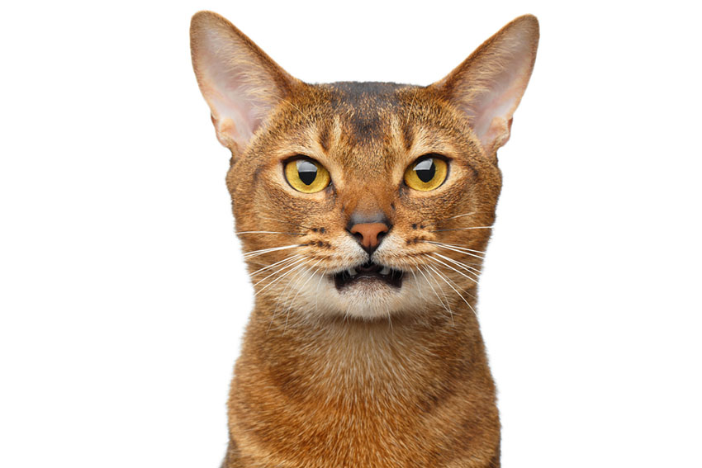
Notes:
Cat

Slide 2

Notes:
Cats and Dogd

Slide 3

Notes:
Pet Shop Boys

Slide 4
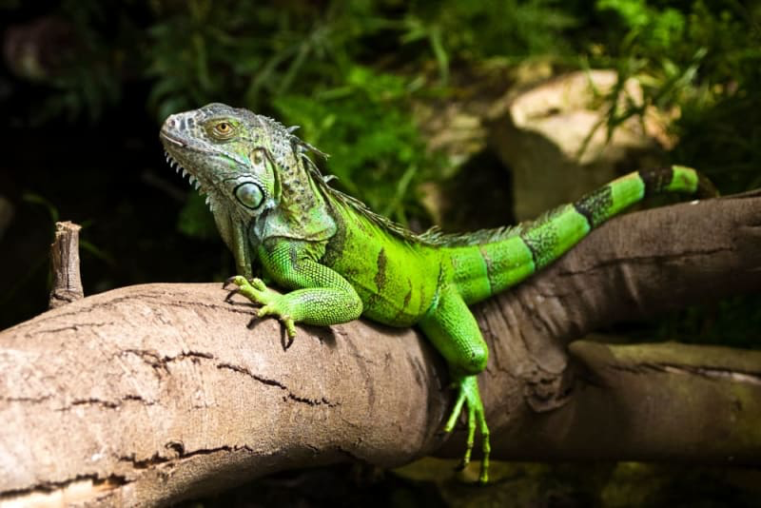
Notes:
Iguana

Slide 5
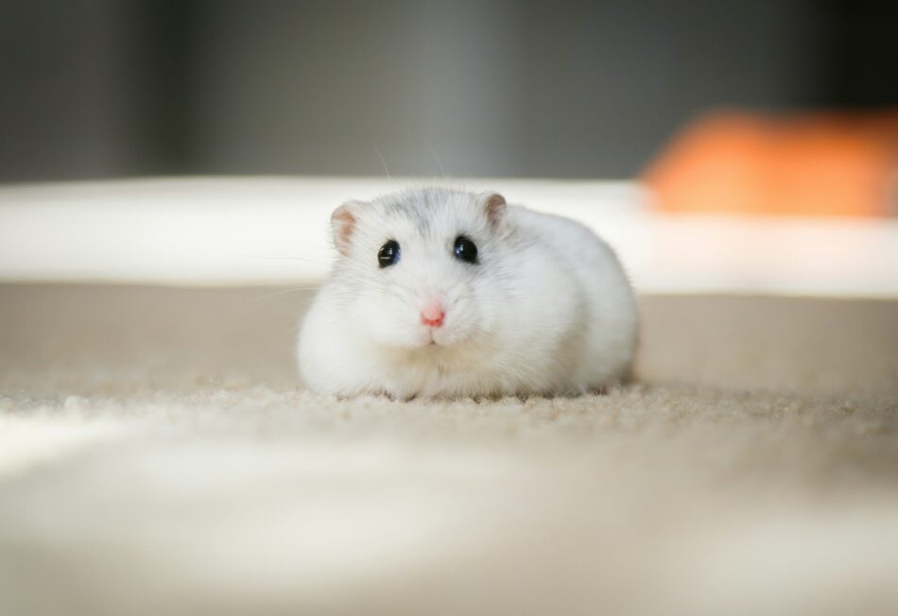
Notes:
Hamster

Slide 6
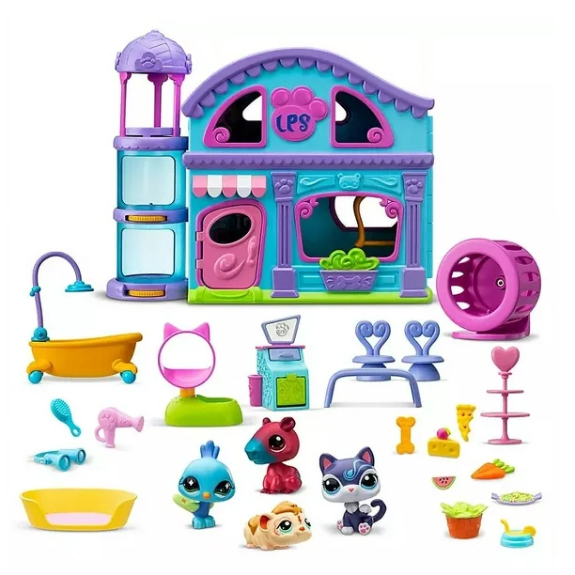
Notes:
Littlest Pet Shop

Slide 7
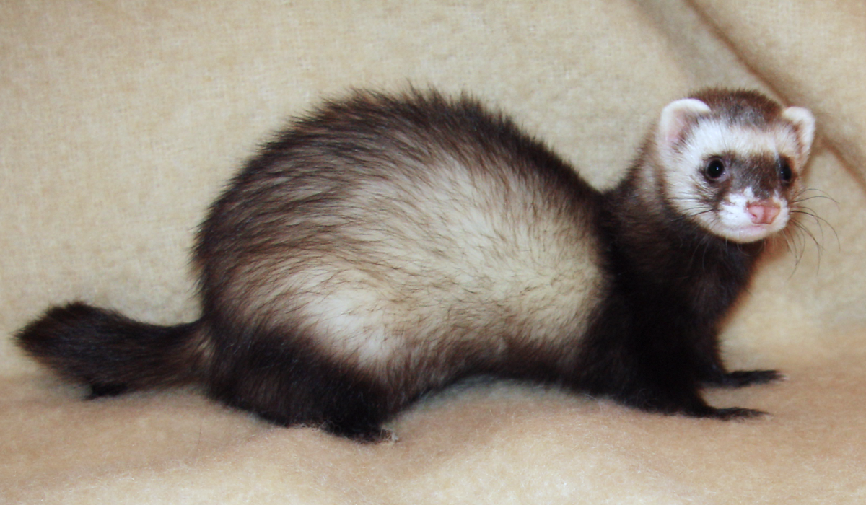
Notes:
Ferret

Slide 8
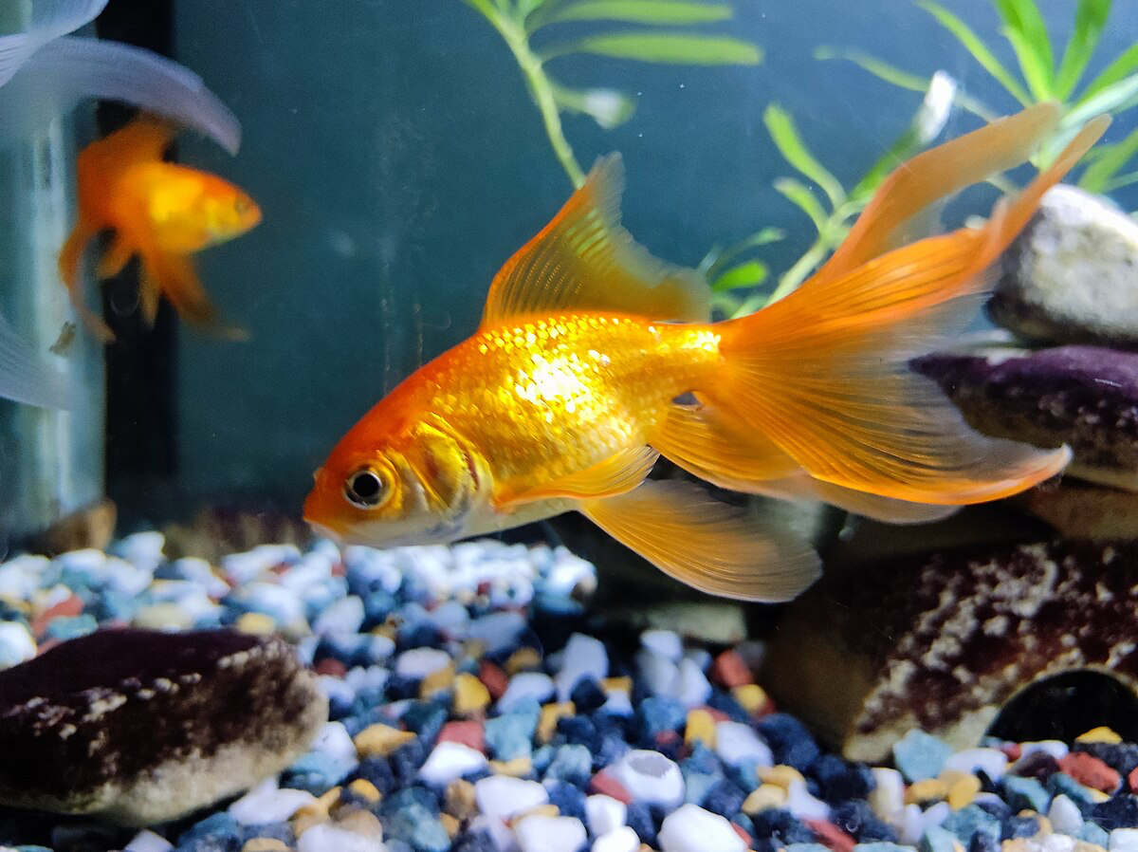
Notes:
goldfish

Slide 9

Notes:
Pet Sounds

Slide 10
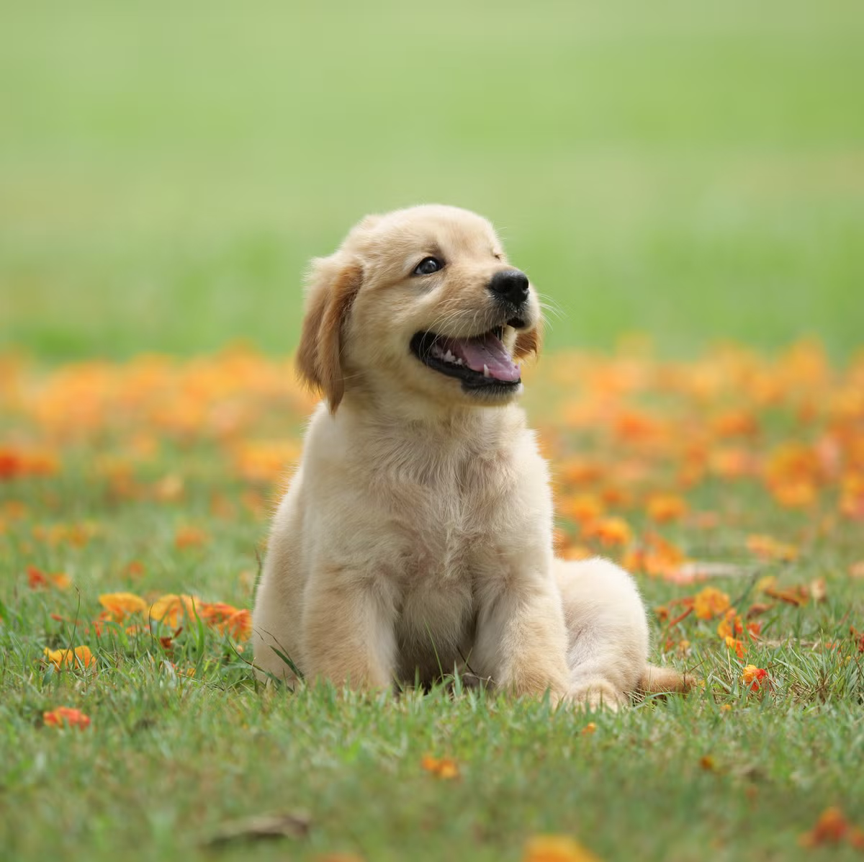
Notes:
dog

Slide 11
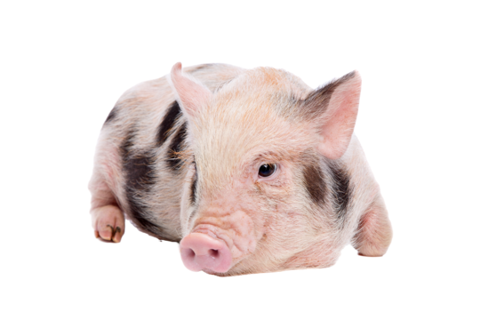
Notes:
Micro pig

